Slide 1


StencilJS
Wouter Gowdy april 2022

Slide 2

About me
Wouter Gowdy
Frontend experience: 2.5 years
Started out with Oracle JET

Slide 3

About me
Wouter Gowdy
Frontend experience: 2.5 years
Started out with Oracle JET
Currently working with StencilJS at Logius / DigiD

Slide 4


What is Stencil?
Created by Ionic
Web component compiler
“Framework” made for webcomponents
Compiles to Vanilla JS, so usable everywhere
Notes:
Ionic themselves call it a webcomponent compiler
I call it a framework
really helps development
Ionic says its not
Theyre probably right

Slide 5



Why Stencil?
my-test-component
Notes:
With the risk of sounding like a salesman

Slide 6
Webcomponents
Independent piece of code
Own variables and logic
Unique HTML tag <my-own-webcomponent/>
Reusable
(can contain other webcomponents)

Slide 7
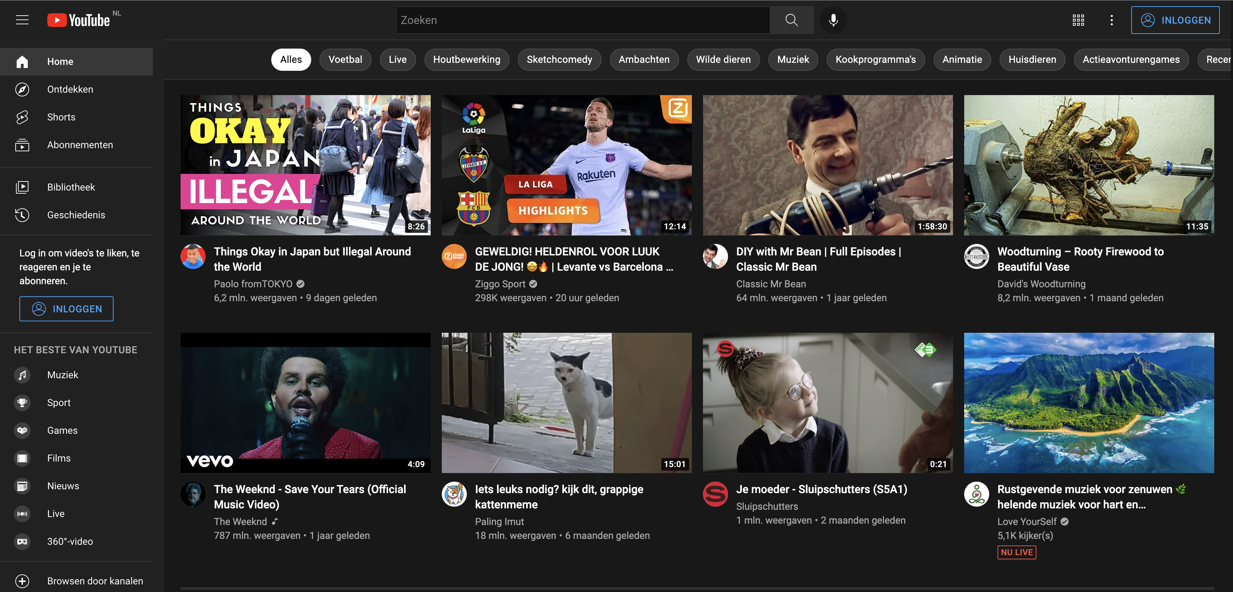
Webcomponents

Slide 8
Webcomponents
yt-video-card

Slide 9
Webcomponents
yt-video-card
yt-video-card
yt-video-card

Slide 10
Webcomponents
yt-mainpage

Slide 11
Webcomponents
yt-category-selector
yt-mainpage

Slide 12
Webcomponents
yt-category-selector
yt-category
yt-mainpage

Slide 13
Webcomponents
yt-category-selector
yt-category
yt-mainpage
yt-video-card

Slide 14
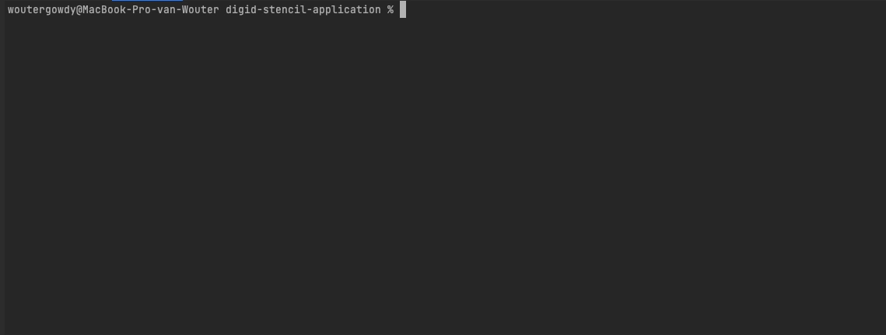
Getting started with Stencil
Npm install stencil

Slide 15
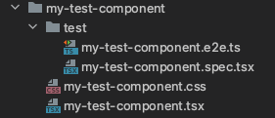
Getting started with Stencil

Slide 16
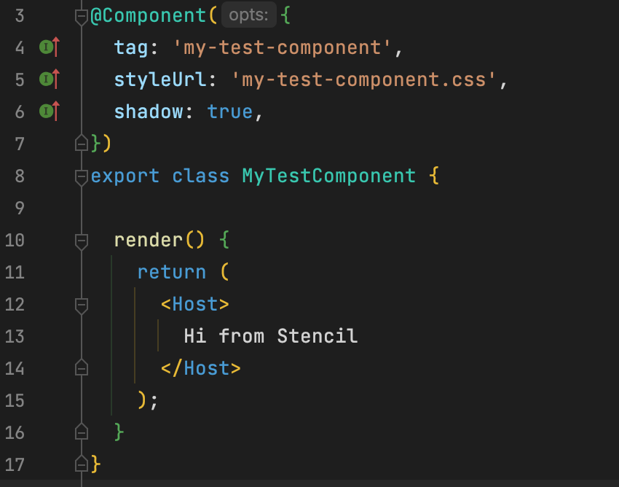
Stencil component structure
my-test-component.tsx
Notes:
Because render is in TSX

Slide 17
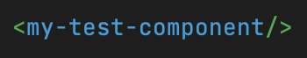
Stencil component structure
my-test-component.tsx
@Component()
Provides the tag and CSS (or scss/sass) file
Notes:
Because render is in TSX

Slide 18
Stencil component structure
my-test-component.tsx
@Component()
Provides the tag and CSS (or scss/sass) file
class {}
Variables, methods and other logic
Notes:
Because render is in TSX

Slide 19
Stencil component structure
my-test-component.tsx
@Component()
Provides the tag and CSS (or scss/sass) file
class {}
Variables, methods and other logic
render()
The componets output, or HTML.

Slide 20
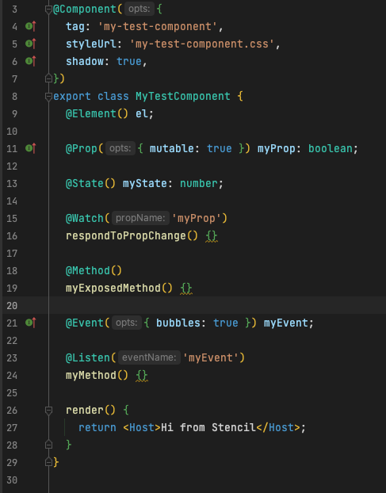
Stencil decorators
@Element()
Reference to the current component

Slide 21
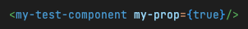
Stencil decorators
@Element()
Reference to the current component
@Prop()
Exposed variables, can be mutable
Notes:
Prop can be added from the outside

Slide 22
Stencil decorators
@Element()
Reference to the current component
@Prop()
Exposed variables, can be mutable
@State()
Internal variables, changes trigger a re-render

Slide 23
Stencil decorators
@Element()
Reference to the current component
@Prop()
Exposed variables, can be mutable
@State()
Internal variables, changes trigger a re-render
@Watch()
Calls function on change to watched variable

Slide 24
Stencil decorators
@Method()
Used to expose a method

Slide 25
Stencil decorators
@Method()
Used to expose a method
@Event()
Creating a custom event, can bubble to outside the component

Slide 26
Stencil decorators
@Method()
Used to expose a method
@Event()
Creating a custom event, can bubble to outside the component
@Listen()
Listen for an event and call a method accordingly
Notes:
There are some more Stencil API’s, but I may have already discussed too many here

Slide 27

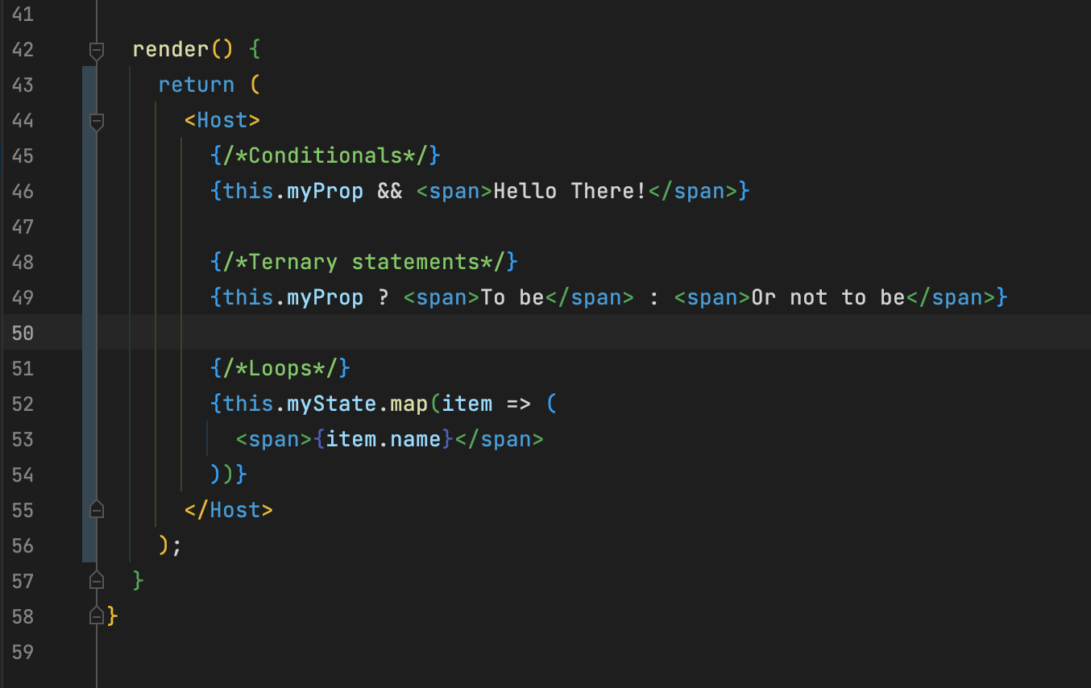



JSX

Slide 28
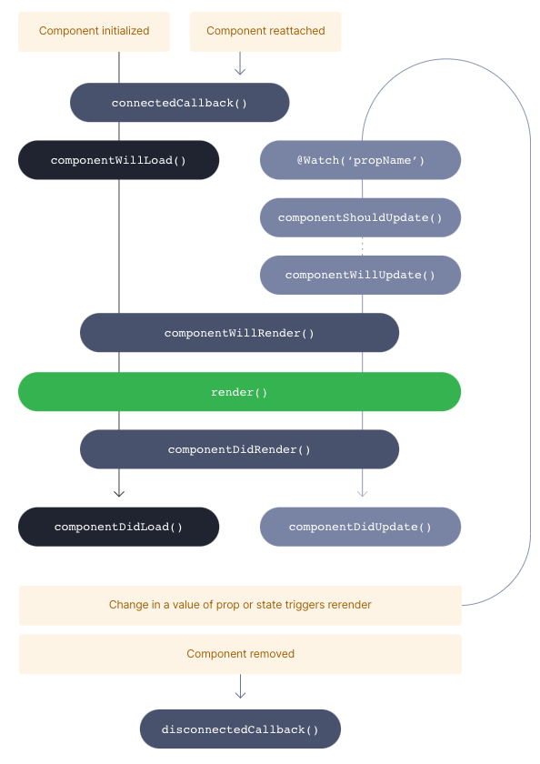
Lifecycle

Slide 29
Lifecycle
Notes:
Will : used to load in data you want to display in your render function
Did: perform computations with the loaded data or add event listeners

Slide 30
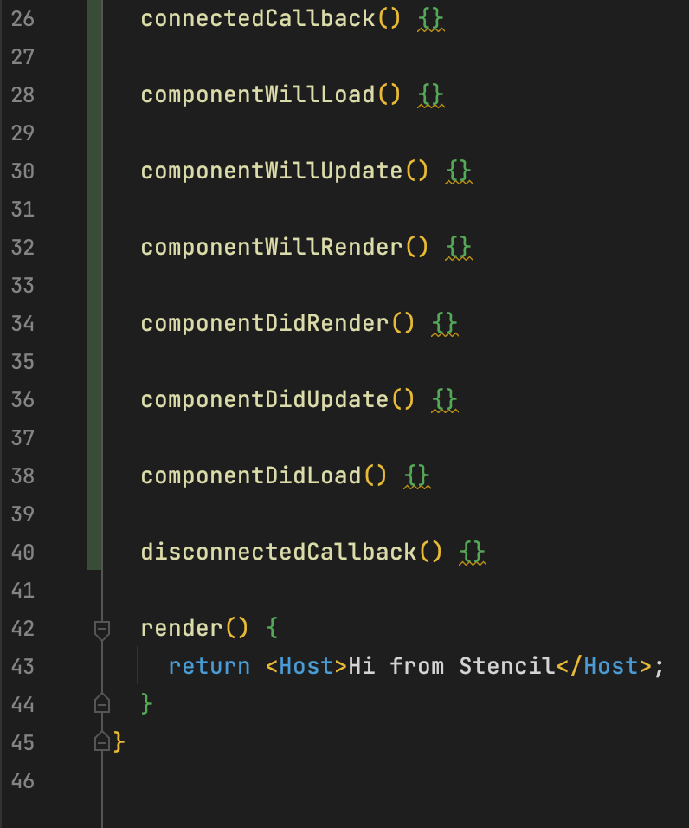

Slide 31
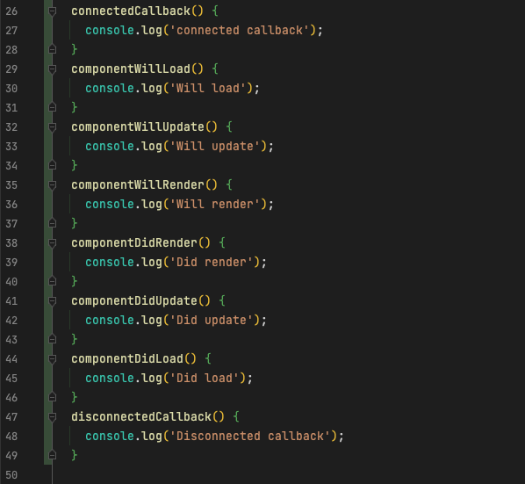

Slide 32
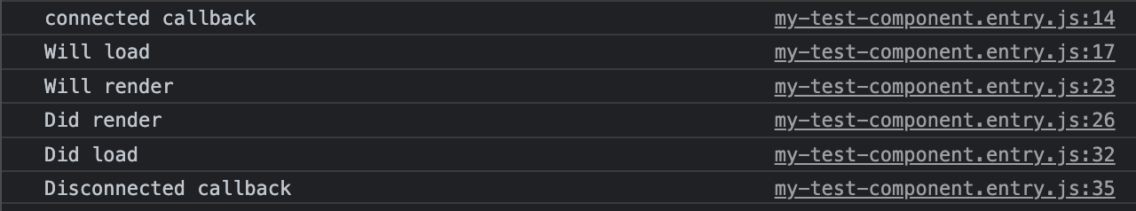

Slide 33
Getting started / tips
https://stenciljs.com/
Udemy training on stencil : https://www.udemy.com/course/web-components-stenciljs-build-custom-html-elements/
Cant find help on a Stencil Issue? Try searching for React
Notes:
Stencil is pretty young

Slide 34
Thank you for your attention!

